Slide 1
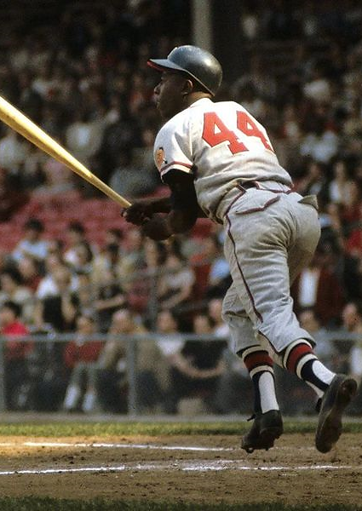
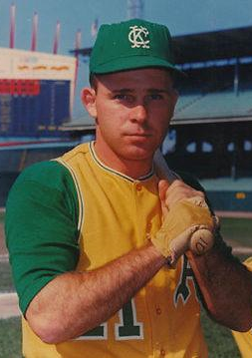
Step 1: Adjust your new photo. The photo needs to be exactly 2.9 by 2.05. Once you have you photo that size, copy the format of the original cards on the left to your photo. This will give it the colored border. I would next sharpen the photo by 25% as the copy format sometimes makes the original a little fuzzy.
Step 2: Copy one of the cards on the left for your base card. I used the Green Border for NL teams and the Red for AL Teams
Step 3: select the photo in the copied card and delete it.
Step 4: Center your photo both middle and center on the base card (now without the original photo). Step 5: Select the base card and the photo and then select ungroup
Step 6: select your original photo and bring it back two places. This will put the S&H and name plates in front of your photo.
Step 7: Group the photo and the base card together.
Step 8: Change the First Name, then Last Name and then Team.
Step 9: Save as a .jpg or .png
Henry
AARON
Braves
Jim
GOSGER
Athletics

