Slide 1
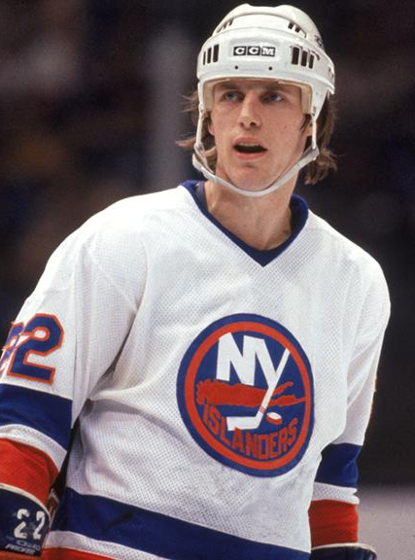
MIKE BOSSY
ISLANDERS
RW

